Slide 1
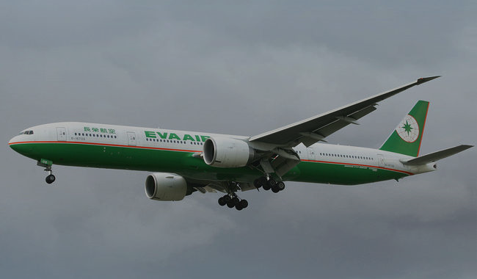
A picture is worth a thousand words

Slide 2
presentation begins
HERE IS WHERE YOUR

Slide 3
Contents
About us
1
Creative info
2
Data analysis
3
This is the subtitle that makes it comprehensible
This is the subtitle that makes it comprehensible
This is the subtitle that makes it comprehensible

Slide 4
Contents
Hey yo yo

Slide 5
The slide
11111

Slide 6
“This is a quote. Words full of wisdom that someone important said and can make the reader get inspired.”
—Someone famous

Slide 7
Maybe you need to divide the content
Mercury is the closest planet to the Sun and the smallest one in the Solar System—it’s only a bit larger than our Moon. The planet’s name has nothing to do with the liquid metal since it was named after the Roman messenger god, Mercury
Venus has a beautiful name and is the second planet from the Sun. It’s terribly hot—even hotter than Mercury—and its atmosphere is extremely poisonous. It’s the second-brightest natural object in the night sky after the Moon

Slide 8
Maybe you need to divide the content
MERCURY Mercury is the closest planet to the Sun and is only a bit larger than our Moon
JUPITER It’s a gas giant and the biggest planet in our Solar System
MARS Despite being red, Mars is a cold place, not hot. The planet is full of iron oxide dust
VENUS Venus has a beautiful name, but it’s terribly hot, even hotter than Mercury
Mercury is the closest planet to the Sun and the smallest one in the Solar System—it’s only a bit larger than our Moon. The planet’s name has nothing to do with the liquid metal since it was named after the Roman messenger god, Mercury

Slide 9
A picture always reinforces the concept
Images reveal large amounts of data quickly, so remember: use an image instead of long texts. Your audience will appreciate that.
Venus has a beautiful name and is the second planet from the Sun. It’s terribly hot—even hotter than Mercury—and its atmosphere is extremely poisonous

Slide 10
And here too!
Images reveal large amounts of data quickly, so remember: use an image instead of long texts. Your audience will appreciate that

Slide 11
The slide
MARS
Despite being red, Mars is a cold place, not hot
JUPITER
It’s a gas giant and the biggest planet in our Solar System
VENUS
Venus has a beautiful name, but it’s terribly hot

Slide 12
The slide
 | MASS (earths) | DIAMETER (earths) | SURFACE GRAVITY (earths)
MERCURY | 0,06 | 0,38 | 0,38
MARS | 0,11 | 0,53 | 0,38
SATURN | 95,2 | 9,4 | 1,16

Slide 13
Awesome words
Because key words are great for catching your audience’s attention

